Slide 1


END2982 MANUFACTURING SYSTEMS
Doç.Dr.Doğan ÖZGEN
SUBJECT: Enterprise Globalization Strategies
PREPARED BY: 16069002 MUSTAFA KALELİ
17069704 KORAY EYYUPOĞLU

Slide 2

Chapter 13
->Enterprise Globalization Strategies
13.1
->WHY ENTERPRISES BECOME GLOBAL
13.1.1 Benefits for Global Enterprises
13.1.2 The Risks of Globalization
13.2
->COUNTRIES OF POTENTIAL NEW MARKETS
13.3
->PRODUCT DESIGN FOR GLOBALIZATION
13.4
->LOCATION OF MANUFACTURING PLANTS
CONTENTS

Slide 3
Chapter 13 Enterprise Globalization Strategies

Slide 4
The pace of globalization is accelerating and shows no sign of reversing course. With the growth of manufacturing capacity in developing countries and advances in communication and transportation, it has become economically attractive for many manufacturing enterprises to consider becoming global. A global company may design a product in one country, buy parts in another country, assemble the product in a third country, and sell it elsewhere.

Slide 5
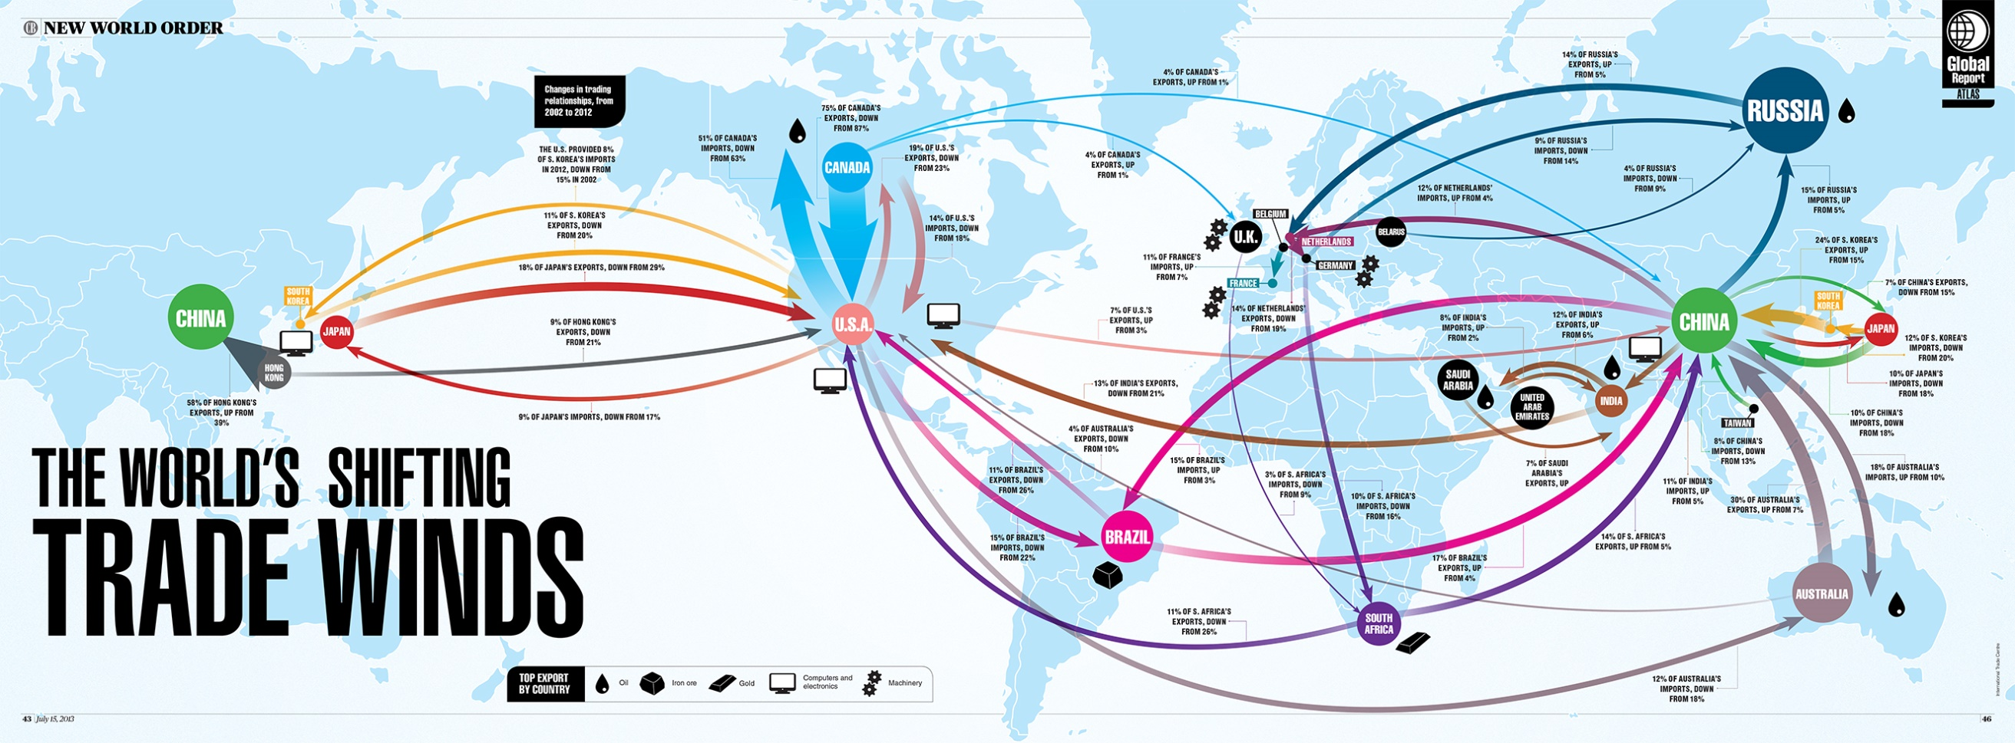

Slide 6
Globalization is the integration and interdependency of world markets and resources in producing consumer goods and services

Slide 7
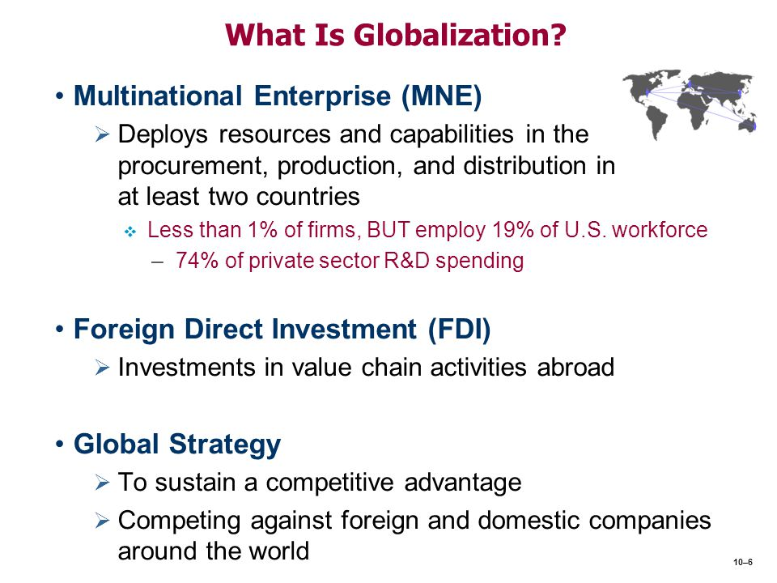

Slide 8
Market integration means opening markets of countries around the globe for buying, producing, and selling with minimal government interference, a process that is greatly facilitated when the countries are members of the World Trade Organization (WTO). Government interference might otherwise include import taxes, domestic production subsidies, trade quotas, or import licenses. The absence of government restriction, combined with the low cost and expediency of communication technologies, makes global access to buyers and sellers easy, and generally reduces product and service pricing for consumers.

Slide 9
Market interdependence means that, in order to prosper, local markets are more dependent on markets in other countries for buying, selling, or producing not only the parts and products they need, but also knowledge and R&D capabilities.

Slide 10
For manufacturing, to a large extent, the pace of globalization is controlled by large enterprises. The successful global manufacturing enterprise typically designs products for different regions on the globe, has manufacturing capabilities in several countries, and sells its products in multiple markets in many countries. Therefore, large manufacturing enterprises in the twenty-first century, whether they like it or not, must prepare strategies for
1. Product design that fits multiple cultures and regulations,
2. Cost-effective, globally distributed manufacturing plants,
3. A business strategy that serves a global multi-cultural market.
The overall growth of a global manufacturing enterprise depends upon the entire worldwide integration of its successful product development, manufacturing, and business strategy

Slide 11
13.1 WHY ENTERPRISES BECOME GLOBAL

Slide 12



13.1 WHY ENTERPRISES BECOME GLOBAL
Globalization enables all enterprises to operate at an international leveL
The development of new communications technologies
English as the international language for science and business
Facilitate the integration of international trade.
Enable the easy exchange of knowledge
among the peoples of the world.
With increased competition

Slide 13
13.1 WHY ENTERPRISES BECOME GLOBAL
Globalization of the manufacturing sector is occurring at an accelerated pace.
Creation of Global “multi-national” enterprises by
The removal of Trade and Financial barriers
The reduction of the cost of communications
Moving products, capital, knowledge and people across borders creates some questions and problems
Security
Prosperity
property
but the benefits are equally compelling.

Slide 14
13.1.1 Benefits for Global Enterprises
Becoming a global manufacturing enterprise has several benefits
Globalization can reduce manufacturing costs
Building plants in lowlabor-cost countries
Shipping parts from cost-effective suppliers
Globalization is a new source for enterprise growth achieved by accessing
New markets
Enlarging the customer base
Avoiding trade barriers by producing within the new market countries
Globalization can reduce the business risk
Since it may smooth the impact of regional business cycles on the revenues of a global enterprise, thereby spreading the business risk across a wider, more diversified market.
Globalization filters currency exchange fluctuations
having revenue sources in many different currencies (e.g., dollar and Euro) , so
Smoothing currency exchange variations
bringing more stability to enterprise earnings.

Slide 15
(Procter & Gamble) P & G
Entered the Chinese market in 1989 with Head & Shoulder shampoo.
Around 1990, P&G at North American had serious financial problems, but
At the same time, Chinese P&G profit and market share increased dramaticaly because of the big market of China.
This is the advantage of spreading a business risk by a global enterprise across a diversed market.

Slide 16
Global markets are complicated, however.
The global enterprise must carefully
monitor currency exchange rates.
A company’s profit margin, of say for example 9%, in one country can be completely wiped out by an equal fluctuation of 9% in the exchange rate of the country in which products are sold or made

Slide 17

Example of Euro/Dolar between 2001- 2005
The fluctuations between the dollar and the Euro during the 4 years 2001–2005 were over 40% (on January 1, 2001: Euro/$= 0.94; and on January 1, 2005: Euro/$=1.36; a 42% change).

Slide 18
German
Company
İnvetsment in
U.S.
United State
German Company has a 9% annual profit in January 2001 (totally 36% over 4 years)

Slide 19

During the same period, exported commodities from the Euro-financed bloc became 40% more expensive in the dollar-
linked financial bloc.

Slide 20
Currency exchange rates can also affect domestic business cycles. When the dollar is weak abroad, U.S. exports to Europe are cheaper, thus more attractive, and their demand increases;
U.S. factories work harder to supply the new demand, and the business cycle in the United States climbs out of a slump.

Slide 21
Clearly, the four benefits of globalization mentioned are not independent from one another.
However, globalization has also potential risks.

Slide 22
13.1.2 The Risks of Globalization
The pressures on an enterprise to consider globalization are unavoidable.
Unless an enterprise plans carefully,
the risks and pitfalls can erode all of benefits.
They constantly monitor itself to survive.

Slide 23
The Risks of Globalization
6 Risk Type of Globalization:
1. Locating Factories Offshore
2. Interdependency of World Markets
3. Currency Exchange Rates
4. Changing Economic Rules
5. Standards and Norms of Imported Products
6. National Sovereignty

Slide 24
1. Risk, Locating Factories Offshore
Risks are unexpected and it does not arise until the investment is already made.
Local work rules
number of working hours
number of permission days…
Ethics (low - cost workforce)

Slide 25
2. Risk, Interdependency of World Markets
An economic downturn in one country can quickly affect the economic situation in other nations.
For instance, financial crysis in U.S. İn Septemper 2008.
Suddenly shut down Factories in China
Send Their Workers Home
Abrupt Downturn in Retail Purchasing in U.S.

Slide 26
3. Risk, Currency Exchange Rates
Currency exchange rates can change dramatically within just a few months.
Damage complex global supply chains that take years to establish.
This is why Manufacrures abondan advantage of their home country.
Toyota and Honda decided to open plants in U.S. because of fluctuating exchange rate.

Slide 27
4.Risk, Changing Economic Rules
Today, Economic rule is different than past.
In the past, the U.S. government invited its
citizens to go shopping to stimulate the economy.
However, in the twenty-first century ,it has very little of the desired effect
money spent is actually used to buy products manufactured overseas.
the only contribution to the domestic U.S. economy is in retail sales, shipping, and handling.
New economy cannot be built on spending alone; it must be based on producing goods domestically.

Slide 28
5. Risk, Standards and Norms of Imported Products
Standards that are part of the landscape of a developed country might be quite rare and difficult to establish in an offshore vendor.
For example,
if the local workforce sees your standards of hygiene and purity as exotic, accidental contamination of the process will be harder to avoid.
If the quality of parts for airplanes and heavy equipment, or the purity of foods and pharmaceuticals is not up to the required standard, disastrous consequences may occur.

Slide 29
6. Risk, National Sovereignty
Cause challenge a nation’s sovereignty over its own conduct and commerce.
Impinges on a nation’s sovereignty by imposing international rules on the local business landscape
The emergence of institutions such as
the WTO, the World Bank, the European Union (EU), Central Bank
add constraints that may have been ignored in the past.

Slide 30
Another Risk, Broad Environmental Problems
Production was shifted to new countries, and brought with it local environmental problems.
But these local problems quickly became global environmental problems.
Global problems require global solutions, and it is not possible to solve them with the local mindset of local governments.

Slide 31
Issues That Addresses A Global Growth Strategy
To become global, it is not enough to buy inexpensive parts from a low-labor-cost country. Which countries are potential new markets? Is the new market large enough to justify adapting products to its regulations and culture?
Which countries are best for producing products, and which countries are better economically suited for producing the components for these products?
How can a product be designed to save production cost so that it sells in many countries while minimizing regional modifications?

Slide 32
13.2 COUNTRIES OF POTENTIAL NEW MARKETS
Globalization can increase the per capita earning potential in developing countries.
This can boost the purchasing power of their population
growing the customer base for new products.
This becomes evident when looking at a previous generation of developing countries.
In the late 1970s, South Korea,
Taiwan,
Singapore,
Hong Kong were developing countries.

Slide 33


13.2 COUNTRIES OF POTENTIAL NEW MARKETS (CONT.)
Prosperity begins with low wages and cheap exports.
As skills increase,
The Value of exported products rises,
Salaries to increase.

Slide 34
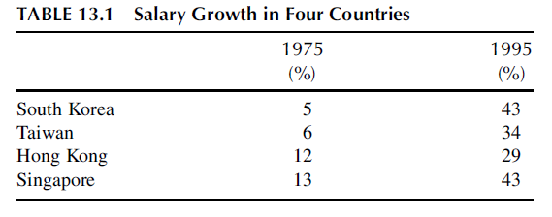
Change In Salaries

Slide 35
13.2 COUNTRIES OF POTENTIAL NEW MARKETS (CONT.)
Expect that
The wages of knowledge workers in China and India will rise substantially within a few years.
This already happens (in 2006) in Bangalore,
India, for software writers pushed wages up towards U.S./European levels.

Slide 36

13.2 COUNTRIES OF POTENTIAL NEW MARKETS (CONT.)
Global enterprises must be prepared
substantial wage increases
for long-term planning & factories in China and India.
At the same time, they have to look at the potential market expansion opportunities there.

Slide 37
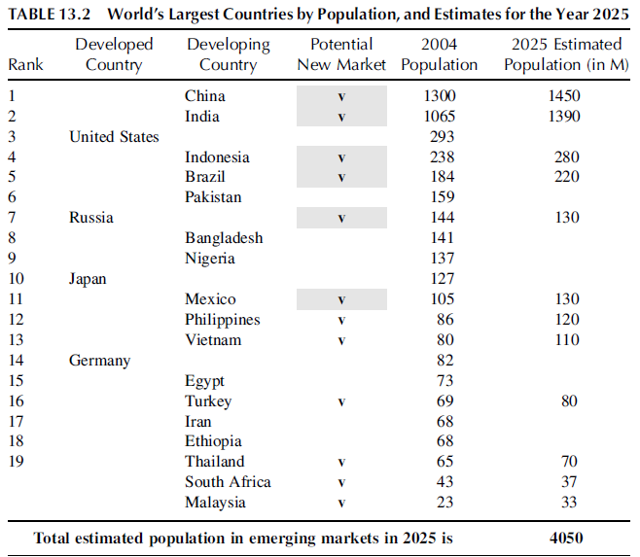
List of Nations with Emerging Markets

Slide 38
13.2 COUNTRIES OF POTENTIAL NEW MARKETS (CONT.)
Table 13.2, growing markets and potential market expansion opportunities.
In 2005, it was estimated that only 10% of the populations of China, India, and Brazil had a purchasing power of over $20,000/ year.
Within a few more years, this percentage will probably double and expand to perhaps 500 million people
create a huge new market for consumer products of all kinds.

Slide 39
13.2 COUNTRIES OF POTENTIAL NEW MARKETS (CONT.)
Of course,
Political stability,
The Availability of Talent
The Working Habits
Also have to be considered when predicting emerging new markets in these countries.

Slide 40
13.2 COUNTRIES OF POTENTIAL NEW MARKETS (CONT.)
There are considerable differences for these 12 country.
Political system
Culture
Climate
must be accounted for when preparing a long-term strategy.

Slide 41
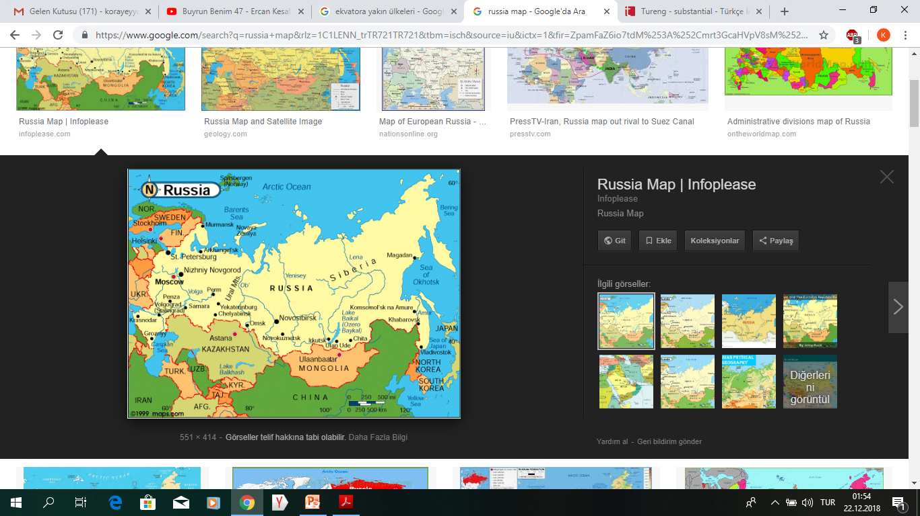


13.2 COUNTRIES OF POTENTIAL NEW MARKETS (CONT.)
For example,
Indonesia Muslim countries Russia
Their needs are likely very different from Russia.
The logistics and distribution systems are substantially different.

Slide 42
13.2 COUNTRIES OF POTENTIAL NEW MARKETS (CONT.)
In just recent years,
The globalization phenomenon has caused a huge shift of wealth and economic power to China and India.
Together they make up about half of the world’s population.
Their integration into the global market has brought tremendous business opportunities and challenges.

Slide 43
13.3 PRODUCT DESIGN FOR GLOBALIZATION

Slide 44
13.3 PRODUCT DESIGN FOR GLOBALIZATION
In all enterprises, strategies for globalization must include three aspects:
1) A business plan built on the four benefits mentioned above in Section 13.1,
2) The strategic location of manufacturing plants,
3) Products that can be customized to fit the requirements of each world market.

Slide 45
13.3 PRODUCT DESIGN FOR GLOBALIZATION
Products designed for one country may be completely inappropriate for sale in another, and product offerings must always match the culture and needs of the local market. Strategically designed products that can be sold in multiple markets with small changes are critical for the global company. In these designs, the product base platform may be identical, but the add-on modules should be tailored to respond to regional culture and local regulations, and also fit the purchasing power of the target population.

Slide 46
This is example of how cultural and regional differences can affect product design:
→ The Japanese buy almost no American cars. U.S. automakers have complained for years that the reason is because of trade barriers imposed by the Japanese government to block foreign companies from competing in Japan. It was not until the late 1980s that a Japanese expert pointed out that the reason was that U.S. automakers tried to sell cars with the steering wheel on the left side (U.S. production), but in Japan automobiles drive on the left side of the road (like in England). To compete globally, U.S. manufacturers must customize their products to fit the regulations and requirements in the destination market.

Slide 47
Example 2
→ Global manufacturers should also be prepared to customize their product offerings to match the life style and culture of their target markets. For example, the size and structure of home appliances depend on living conditions and shopping habits. Apartments in Hong Kong, Tokyo, and in major European cities (e.g., Paris, Milan) are small, and therefore clothes dryers are commonly installed on top of the washing machine. The typical top loading washing machine in the United States would not fit these markets.

Slide 48
Example 3
→ Another example is the size of refrigerators that people buy, which usually depends on the size of the living quarters and shopping habits. Americans tend to have larger homes and do most of their food shopping once a week in supermarkets. In many European cities, the apartments tend to be smaller and there are many neighborhood grocery stores. Europeans do not mind shopping more often and they prefer their foods fresh and not canned or frozen.

Slide 49




To assist in global product development, many enterprises (e.g., GM, Microsoft) have opened global networks for product design. Their goal is only to access the best talents from different countries and to develop real global products. Designers from different cultures think in different ways that can collectively lead to enhanced product design and innovation.

Slide 50
Ordinarily, as products are more customized, their prices should increase. But, sometimes the global market does not allow this to happen. Manufacturers need to appreciate the tradeoff between levels of customization and the manufacturing cost. Microsoft, for example, develops customized, regionalized products to serve its customers in many countries. This is a strategic decision that may not, in itself, generate a profit.

Slide 51
For the most part, customization of their Office software means making it operational in languages other than English. However, when the user population of a particular language is small, Microsoft does not profit by that customization. For example, Microsoft offers its products in Hebrew, although the only country in the world that uses Hebrew is Israel with a population of only 7 million people. This customization by itself is not profitable, but it maintains the company’s position as a leading global company.

Slide 52
13.4 LOCATION OF MANUFACTURING PLANTS

Slide 53
Where should a global manufacturer locate its manufacturing facilities?
Should enterprises locate their manufacturing plants in countries with the lowest labor rates or in the countries where the final products will be sold?
What other factors should be taken into account when making this decision?
?
?
?

Slide 54
Determining plant location is one of the most critical decisions since “brick and mortar” investments are expensive to build and the hardest to change. Choosing the right location can provide a strategic advantage to the enterprise.
In 1999, Ford Motor Company decided to build an advanced engine plant in Windsor, Ontario, Canada, only 5 miles from the United States to Canada border. The engines are shipped from there to automotive assembly plants in Michigan across the Detroit River. The wage rates at that time were lower in Canada than in the United States, but this was not the deciding factor at the time. The main issue was the cost of employee health insurance. Canada has a national health insurance plan, while in the United States health insurance is private, expensive, and a major concern in labor contracts between the employer and the employees.

Slide 55
In addition to health insurance example:
Historically “the Big-3” automakers have provided generous health benefits to their employees. Mr. Gary Cowger, Group Vice President for Global Manufacturing at General Motors confirms that the price of every car sold in the United States during 2004 included $1200 in health insurance costs for GM employees and retirees. Unlike its main competitor, Toyota U.S. does not have this burden of employee health insurance, and this enhances its competitive advantage. Health insurance coverage and other fixed costs can easily become deciding factors.

Slide 56
Other deciding factors for plant location might be local tax rates, government environmental regulations, and government subsidies for new plant construction.
Intel built a Pentium-4 fabrication plant in Israel in 1999 largely because of a government cash subsidy of $600 million against their total investment of $1.8 billion. Ireland, in addition to having an English speaking population, has succeeded in attracting new manufacturing plants by offering low corporate tax rates and large cash subsidies

Slide 57
Even so, low labor-cost countries such as China, Mexico, and Brazil have continued to be attractive manufacturing sites over the past decade. However, it may not be economical to both produce parts and assemble them to final products in low-cost countries.
Refrigerators, for example, should be built close to the target market. Transporting a refrigerator is expensive, particularly when shipping cost is determined by volume (such as transport by sea) rather than weight. Fluctuating fuel prices ($70 for a barrel of oil in September 2005, $140 in April 2008, and $37 in February 2009) also call the remote-site production model into question, and with more volatile the fuel prices, profitability can vary constantly, especially for large products

Slide 58
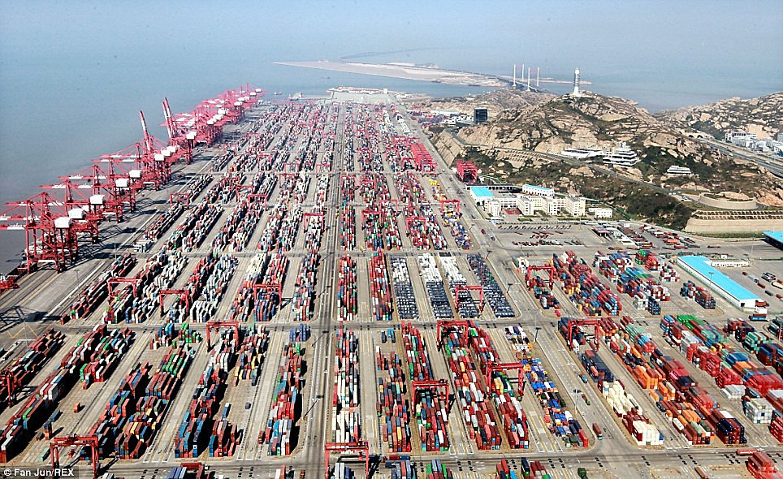
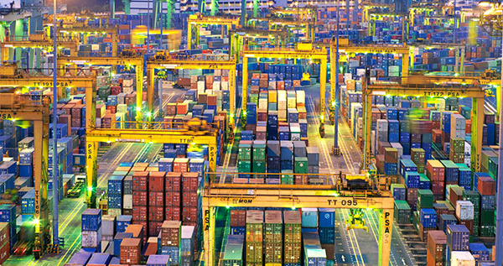
World’s Largest Port: Shanghai Port
→ Something as simple as poor roads between a plant and a nearby port or airport can delay shipping of products. That’s why the most attractive offshore facilities are often those near the most modern export terminals. In China, most industrial development is in cities like Shanghai and Guangzhou that are near the ocean and have modern airports. Reliable transport may be further exacerbated by strikes in the ports and airports, which tend to occur frequently in some countries

Slide 59
Based on these examples, a useful strategy for global manufacturers may be:
Produce labor-intensive, mass-produced parts in low-labor-cost countries.
Build final assembly plants in the target market country,
But keep production of proprietary and critical parts in the home country

Slide 60
In planning resources, another important question is how one can design manufacturing plants so that production can be quickly shifted from one country to another to take advantage of changing conditions, such as fluctuating currency exchange rates. To be effective, a production shift from country to country must be quickly executed within a several months. To be able to move whole factories, the equipment and production systems must be modular and reconfigurable such that they can be readily shipped to the new location and install there at the required capacity and provides exactly the functionality. When making these kinds of changes, compensation and transition for the workers in the ramped-down plants should also be considered, especially if they ever want them to come back.

Slide 61
The issue of where to locate manufacturing facilities in a global market is very important

Slide 62
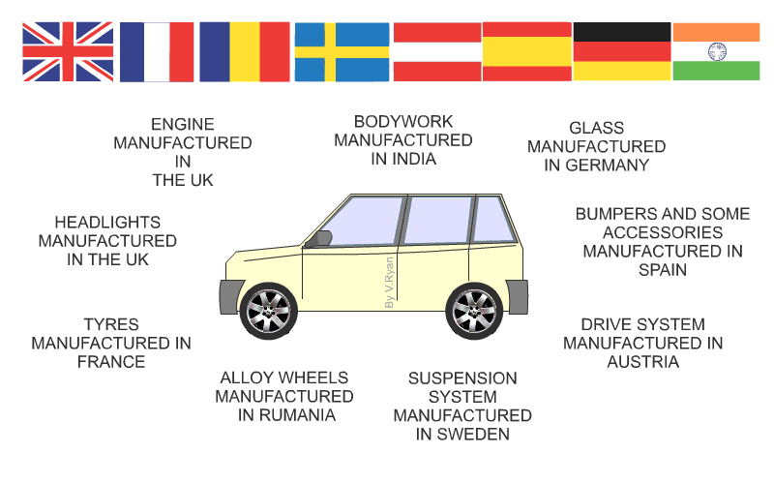

Slide 63
THANKS FOR LISTENING

